Slide 1
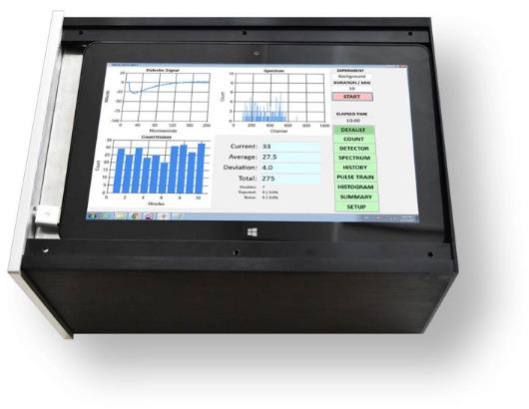
Neutron Radiation: Measurement Best Practices Max Fomitchev-Zamilov, Ph.D. Maximus Energy Corporation founder@maximus.energy www.maximus.energy

Slide 2
Neutron Detection Basics
Neutrons can be broadly classified as:
Fast: E_{k} > 1 MeV,
Slow: E_{k} ~ 10 eV,
Thermal: E_{k} ~ 0.025 eV.
Each class requires it’s own special detection technique.
Neutrons are usually rare: statistical analysis is necessary!
Natural neutron background can vary wildly: statistical analysis in necessary!
Detection probability exponentially increases with the decrease in neutron energy.

Slide 3
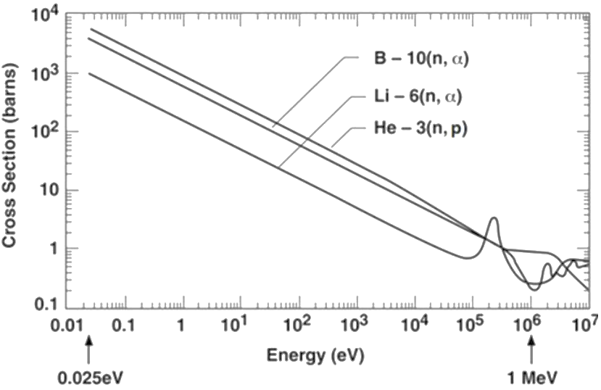
Neutron Absorption Cross-Section
A thermal neutron is ~10 000 easier to detect than a fast one!
Helium-3 is almost 10 times more sensitive to thermal neutrons than Lithium-6.

Slide 4
Neutron Moderators
Hydrogen
Water, oil, organics
High-density ultrahigh molecular weight polyethylene (HDPE)
Absorbs thermal neutrons
Deuterium
Heavy water
Expensive
Graphite
Must be boron-free
Beryllium
Expensive, dust is very toxic (hence difficult to machine)

Slide 5
Moderator Positioning
Extended Source
Moderator
Compact Source
Moderator
Detector
Detector
Optimal moderator thickness depends on neutron energy:
Fast neutrons: 5-10 cm of HDPE
Thermal neutrons: moderator not needed! It will absorb them
Cold neutrons: will be absorbed by environment, even by the air

Slide 6
Common Neutron Detector Types
Thermal neutrons
Proportional counters: ³He, ¹⁰BF₃, ¹⁰B
Corona mode counters: typically stronger single than proportional counters
Fast neutrons: ⁴He, CH₄, liquid scintillators
Crystal scintillators: ⁶Li glass, NaI(Tl + Li)
Bubble detectors
Track detectors: CR39
Solid-state: ⁶LiF₆, ¹⁰B over silicon diode

Slide 7
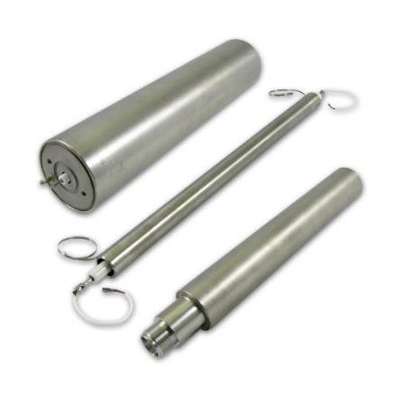
Proportional Counters ³He / ¹⁰BF₃ / ¹⁰B
Very high thermal neutron sensitivity
Sensitive to electromagnetic interference
Sensitive to gamma radiation, gamma rejection is a must
Old soviet SHM-18, SI-19N are good for research

Slide 8
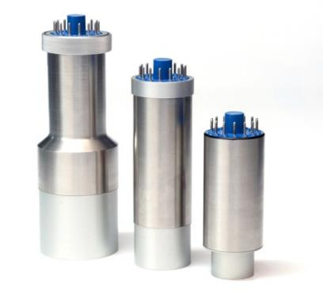
⁶Li Glass Crystal Scintillators
High thermal neutron sensitivity
Not as sensitive to EM interference as proportional counters
Sensitive to gamma radiation, gamma rejection is a must

Slide 9
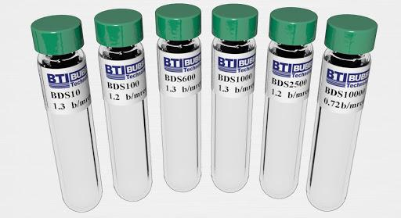
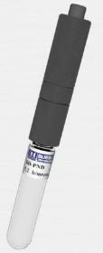
Bubble Detectors
Made by Bubble Technology Industries (BTI), Canada
Made for different energy ranges (e.g. one can order a 6-vial spectrometer)
Insensitive to electromagnetic interference, x-ray or gamma radiation
Inexpensive: ~$300 ea.
Low neutron sensitivity (~1000 less than ³He)
Useful life: 1-2 years
Sensitive to vibration, shock and heat (cause bubbles)

Slide 10
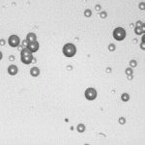
CR39 Plastic Track Detector
Widely available from Landauer, USA
“Gold standard” for publication
Very inexpensive: ~$20 ea. under dosimetry subscription service
Do not provide real-time counts: require etching and counting under microscope (automated under Landauer subscription service)
Very low sensitivity (10,000 less than ³He)

Slide 11
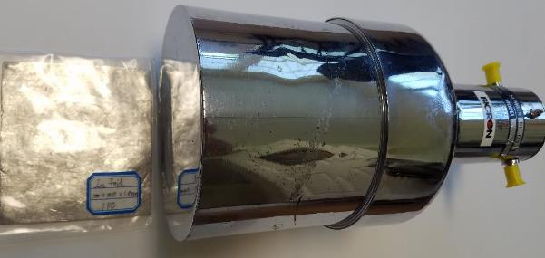
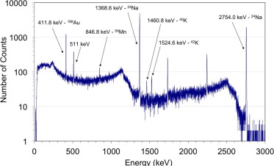
Neutron Activation
Irradiate indium, gold, silver or europium foil
Acquire gamma spectrum
Requires large (3-5”) NaI or germanium (HPGe) detector in a lead shield

Slide 12
Proportional Counter Properties
³He gas pressure: 0.5 – 20 bar
SI-19N/SNM-18: 2-3 bar
Dimensions: diameter 5-50 mm, length up to 2 m
Bias voltage: 800-1,500V
Pulse amplitude: 10-100 mV
Pulse rise time: 1-20 μs
Background: 1-5 CPM*
Efficiency: 60-90%*
Sensitivity: depends on geometry, gas pressure:
CPS/nv – counts per second per neutron per 1 cm².

Slide 13
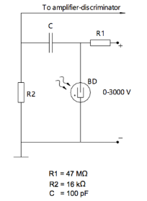
General Counter Diagram
Bias Power Supply
Counter
Detector
Filter
Preamp
Discriminator
Short Cable
Long Cable

Slide 14
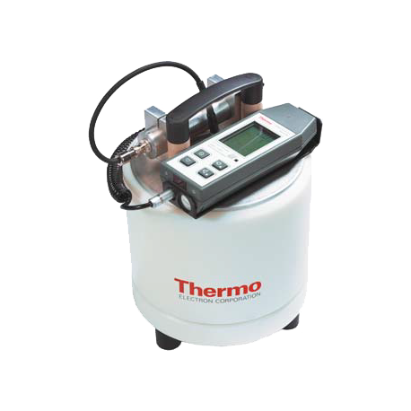
Do Not Use “Black Box” Systems
Interference
Incorrect Measurements
“Black box” systems are not suitable for scientific studies

Slide 15
Simplified Detector Schematics
Bias Power Supply
Detector
Filter
Preamp
Computer

Slide 16
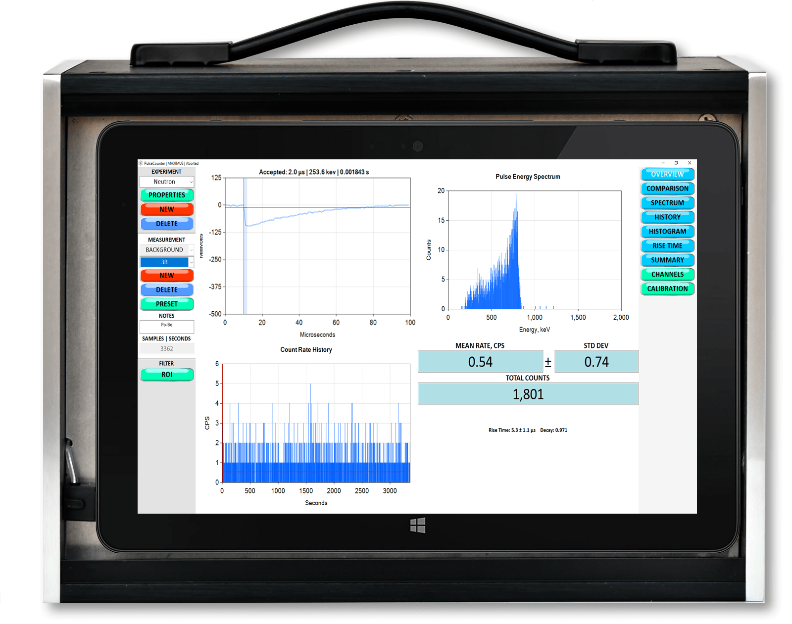
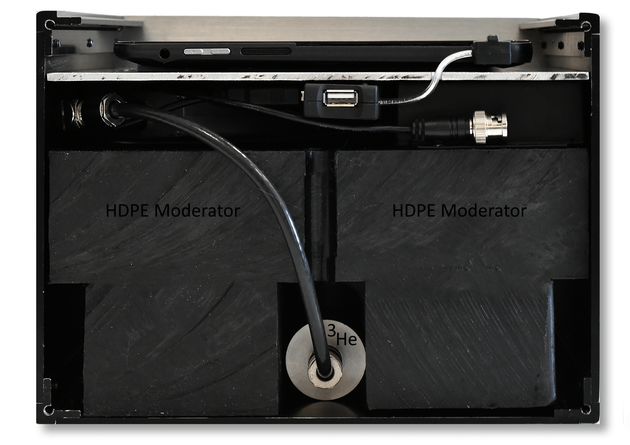
NEUTRON-PRO System
http://maximus.energy/index.php/product/neutron-pro/

Slide 17
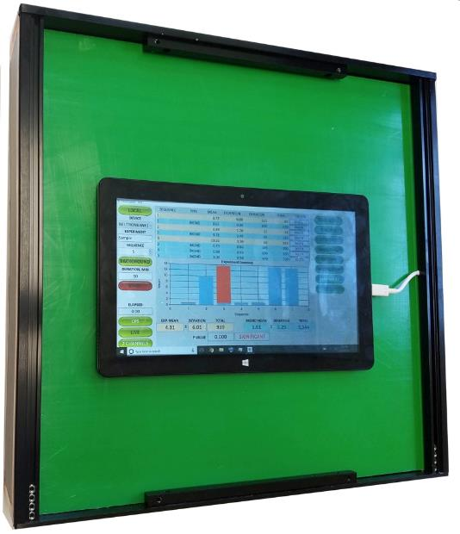
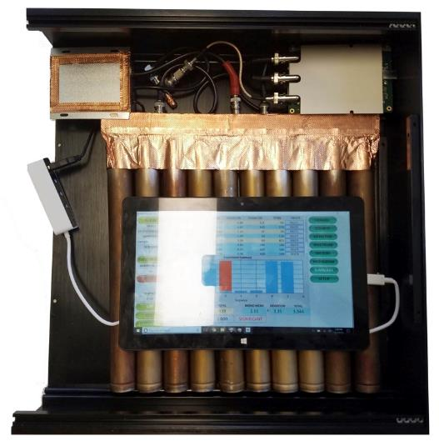
NEUTRON-BANK 12 x 12”

Slide 18
PulseCounter Software
http://maximus.energy/index.php/software/

Slide 19
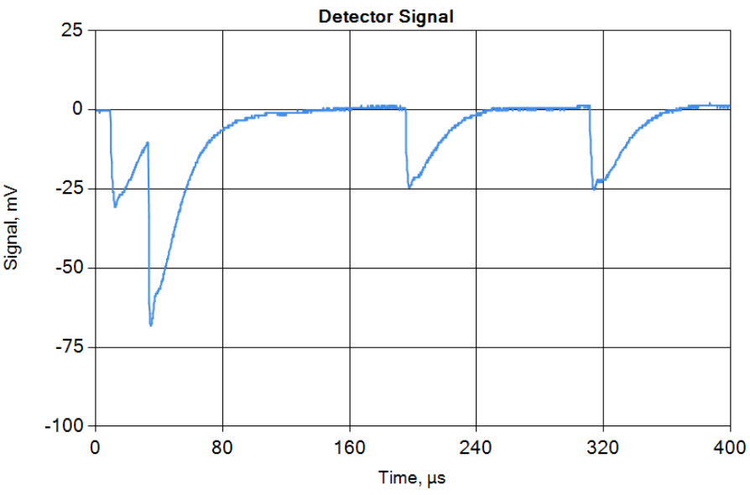
³He Counter: Proportional Mode
Baseline: 0V
Trigger level: -5 mV
Pulse amplitude: 25 mV
Pulse width: ~100 μs
Pulse rise time: 12 μs

Slide 20
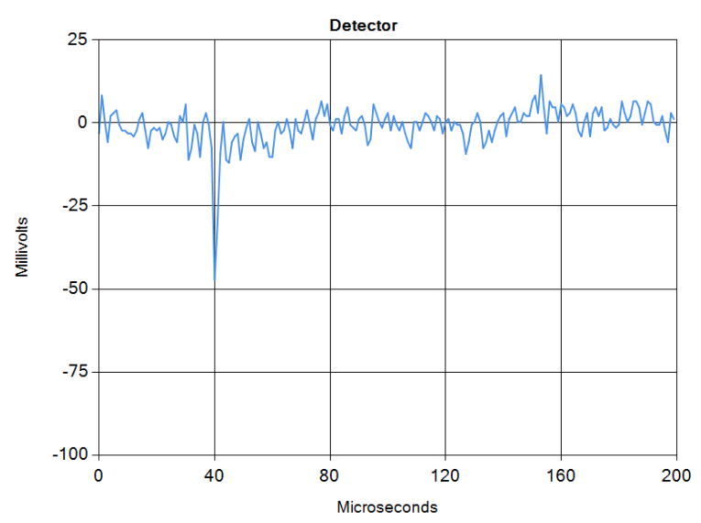
³He Counter: Corona Mode
Corona noise
Trigger level (discriminator)
Purported neutron pulse

Slide 21
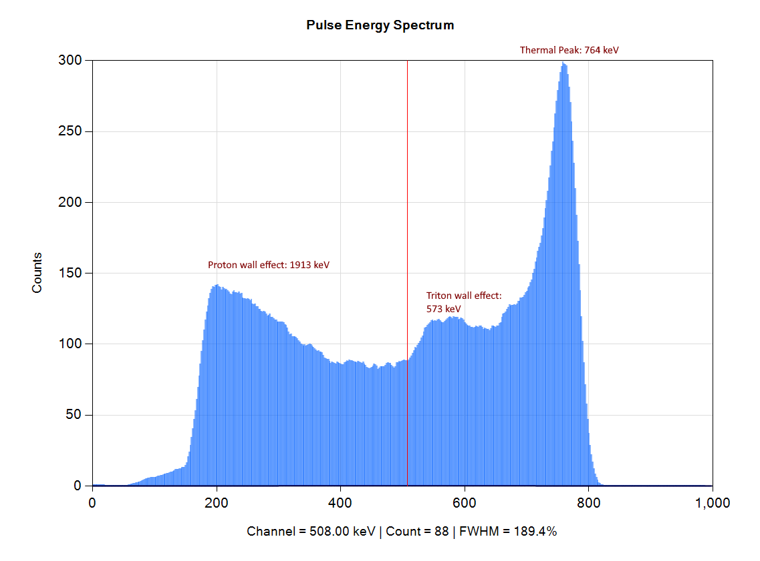
Thermal Neutron Spectrum
Thermal peak: 764 keV
Proton continuum to 573 keV
Triton continuum to 191 keV

Slide 22
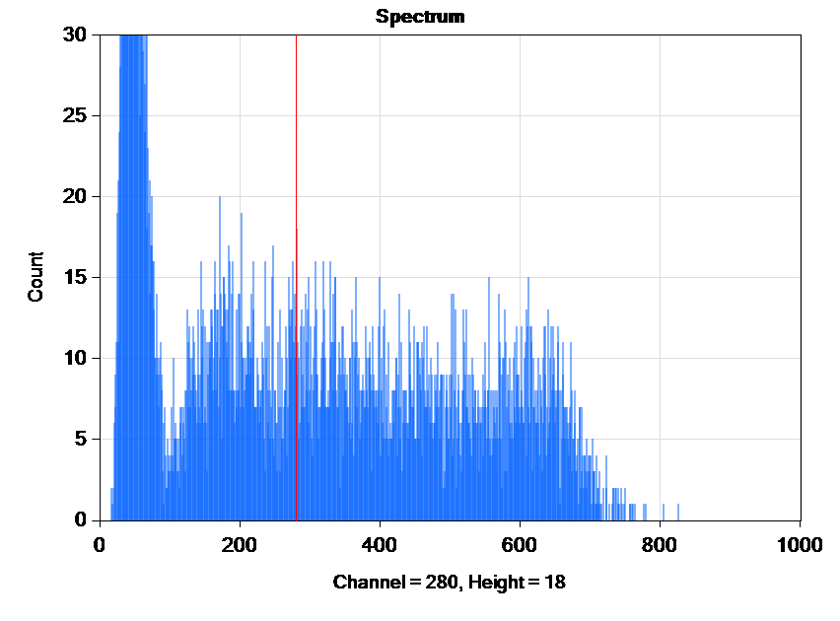
Gamma Rejection
Gamma peak
Gamma peak creeps to the right as the intensity of x-rays increases
Neutron spectrum

Slide 23
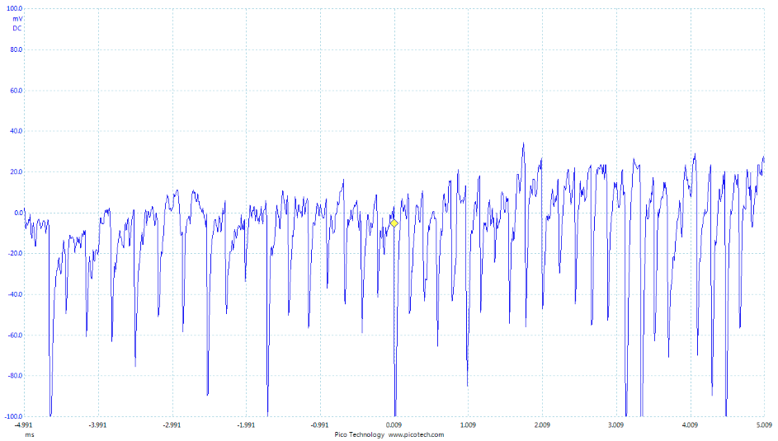
Gamma Rejection
Neutron detector overwhelmed by x-rays

Slide 24
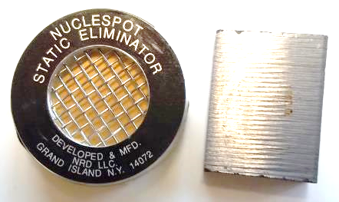
Neutron Check Source
Nuclespot P2042 5 mCi ²¹⁰Po alpha source available at www.amstat.com
Cover with beryllium and obtain a check source on the order of few thousand of neutrons per second!
People also use ²⁴¹Am, ²³⁹Pu from smoke detectors
Few-Ci ²⁵²Cf calibration source is the best but it is expensive and requires an NRC license

Slide 25
Systematic Errors
Proportional counters are very sensitive to EM interference!
Intrinsic noise may cause false low-energy peaks and may affect the counting rate!
Periodic EM noise (e.g. power supply noise) may add a parasitic periodic component to the counting rate!
Gamma radiation requires careful gamma rejection.
Bias or amplifier drift may impact the counting rate!
Natural neutron background may vary wildly, especially when too few measurements are taken.
Human body is a good moderator, may affect the counting rate.

Slide 26
Random Processes
We are dealing with random processes. That is why we cannot draw conclusions after making only 1-2 (or a handful) of measurements;
Too few measurements can yield odd patterns, including some pretty incredible ones;
“Non-repeatable” results are (most likely) just odd samples drawn from random distribution.

Slide 27
Statistical Analysis
Sample the background: ≥20 samples
Sample the experiment: ≥20 samples
Calculate P-value: if the value is less than 5% it is customary to consider the difference between the experiment and the background to be “statistically significant”.
If the P-value changes significantly with the addition or removal of samples – you do not have enough samples in your data set.

Slide 28
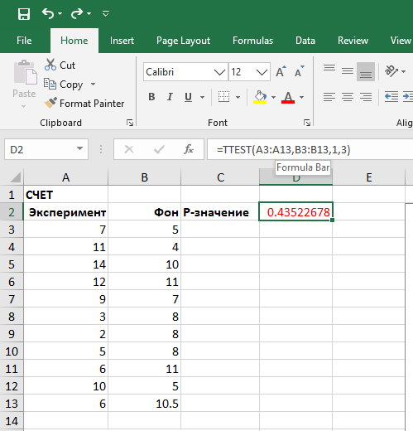
How to Calculate P-Value in Excel

Slide 29
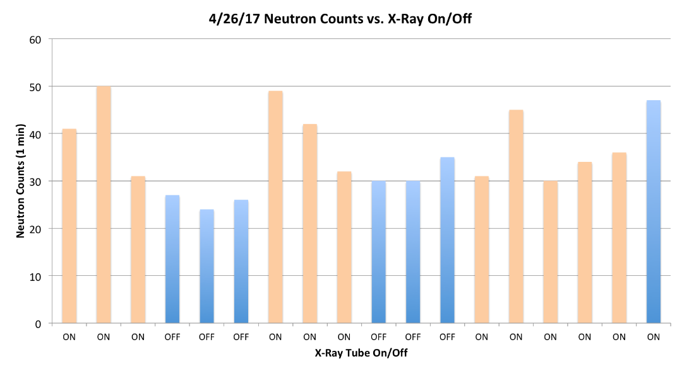
Statistical Analysis: Example #1
P-value = 0.0007 !!!
Interesting… But too few (<30) measurements to be convincing

Slide 30
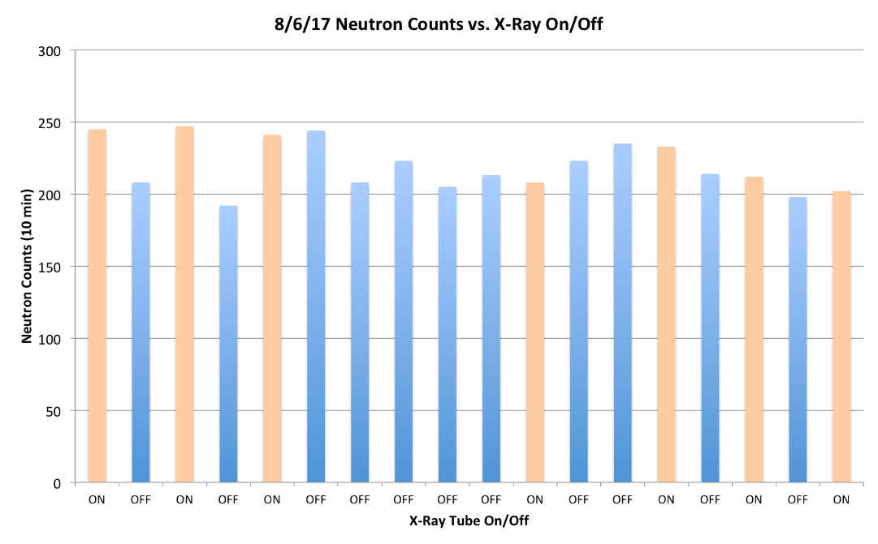
Statistical Analysis: Example #2
Interesting… But this is just a “lucky” pattern

Slide 31
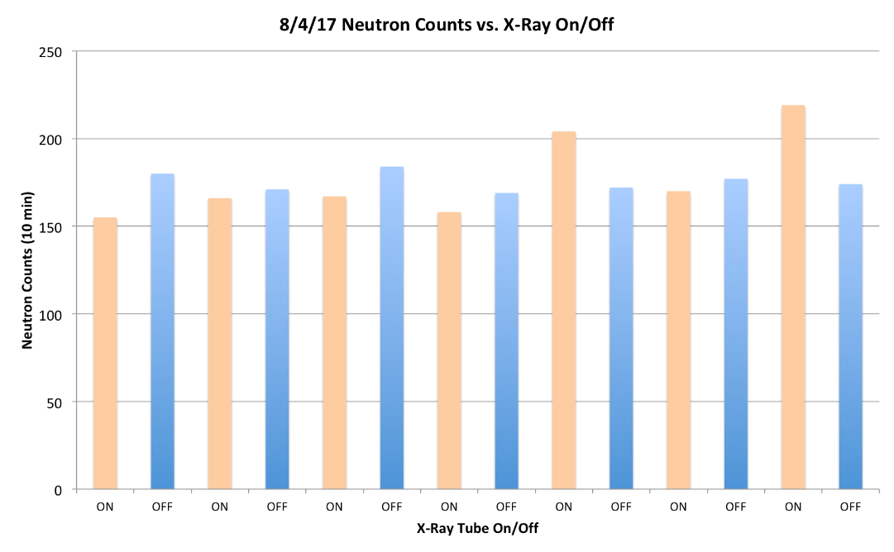
Statistical Analysis: Example #3
One cannot discard lower “experiment” counts as errors

Slide 32
Neutron Detection Best Practices
Configuration
Cover the detector in lead foil to suppress gamma
Use moderator: 2-4” of HDPE is usually enough
Place the detector and all the electronics in a metal enclosure (Faraday cage)
Employ battery power to avoid ground loops
Record the detector signal for off-line analysis and pulse shape audit
Calibration
Use a neutron check-source (e.g. 5 mCi Po-Be) to check the detector: the detector must respond to the source
Use a gamma source (e.g. 10 μCi ¹³⁷Cs) to verify gamma rejection: the detector must not respond to the source

Slide 33
Neutron Detection Best Practices
Experiment
Place the detector as close to the purported neutron source as possible
Use gamma detector for gamma intensity & spectrum monitoring
Statistical Analysis
Check background regularly: record 20+ measurements each time
Record 20+ “experiment” measurements each time
Calculate P-value
Statistics will improve with the increase in the number of measurements
Secondary Means of Confirmation
Use bubble detector to verify / confirm the neutron flux
If the neutron flux appears large use indium foil activation to verify / confirm the neutron flux

Slide 34
Useful Resources
http://maximus.energy/index.php/product/neutron-pro/
http://bubbletech.ca/product_type/bubble-detector-products/
https://amstat.com/esd-ionizer/nuclespot-alpha-ionizer/

