Slide 1
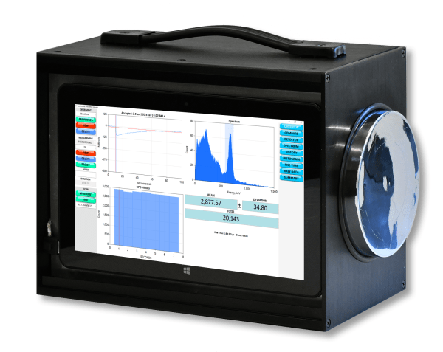
X-Ray & Gamma Radiation: Measurement Best Practices
Max Fomitchev-Zamilov, Ph.D.
Maximus Energy Corporation founder@maximus.energy www.maximus.energy

Slide 2
Philosophy of Discovery
Form a hypothesis, describe confirmation and falsification criteria;
Subdue your ego: the truth is more important;
Question everything including your own conclusions;
Look for errors and you will find them;
Invite critique from everybody, especially from peers.

Slide 3
Philosophy of Measurement
Understand how your measurement devices work;
Achieve repeatability of measurements;
Study and eliminate systematic errors;
Employ alternative measurement techniques;
Use bank controls: the effect must disappear;
Use broad controls: the effect must increase/decrease when you vary critical parameters;
Do not forget the statistical analysis.

Slide 4
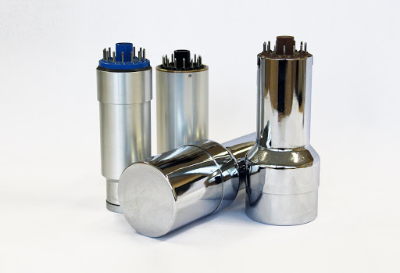
Gamma Radiation Detectors
Spectroscopy-Grade NaI(Tl) Scintillators

Slide 5
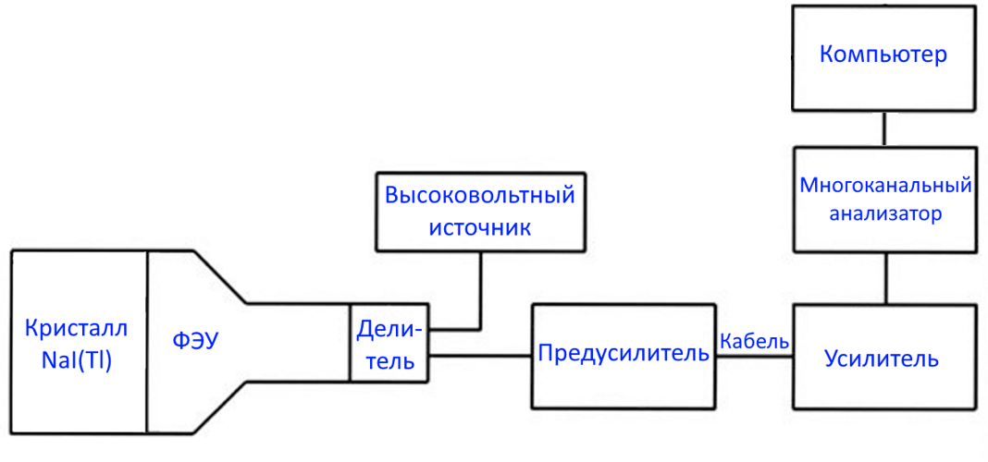
Gamma Spectrometer Schematics
Computer
HV Power Supply
MCA
NaI(Tl) Crystal
PMT
Voltage Divider
Preamp
Cable
Amplifier

Slide 6
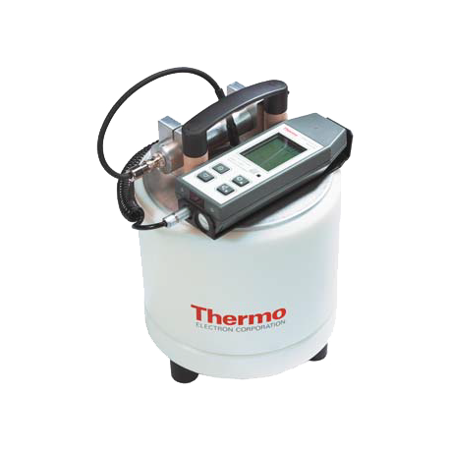
Do Not Use “Black Box” Systems
Interference
Incorrect Measurements
“Black box” systems are not suitable for scientific studies

Slide 7
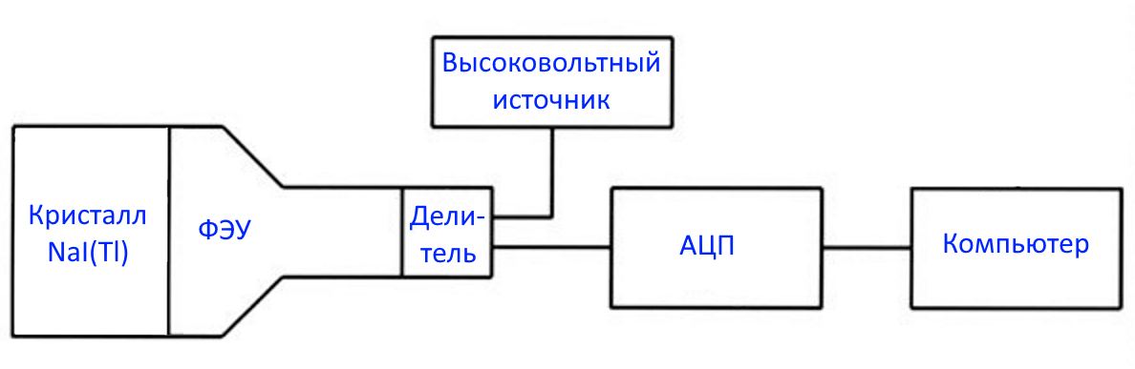
Gamma Spectrometer Simplified
HV Power Supply
NaI(Tl) Crystal
PMT
Voltage Divider
ADC
Computer

Slide 8
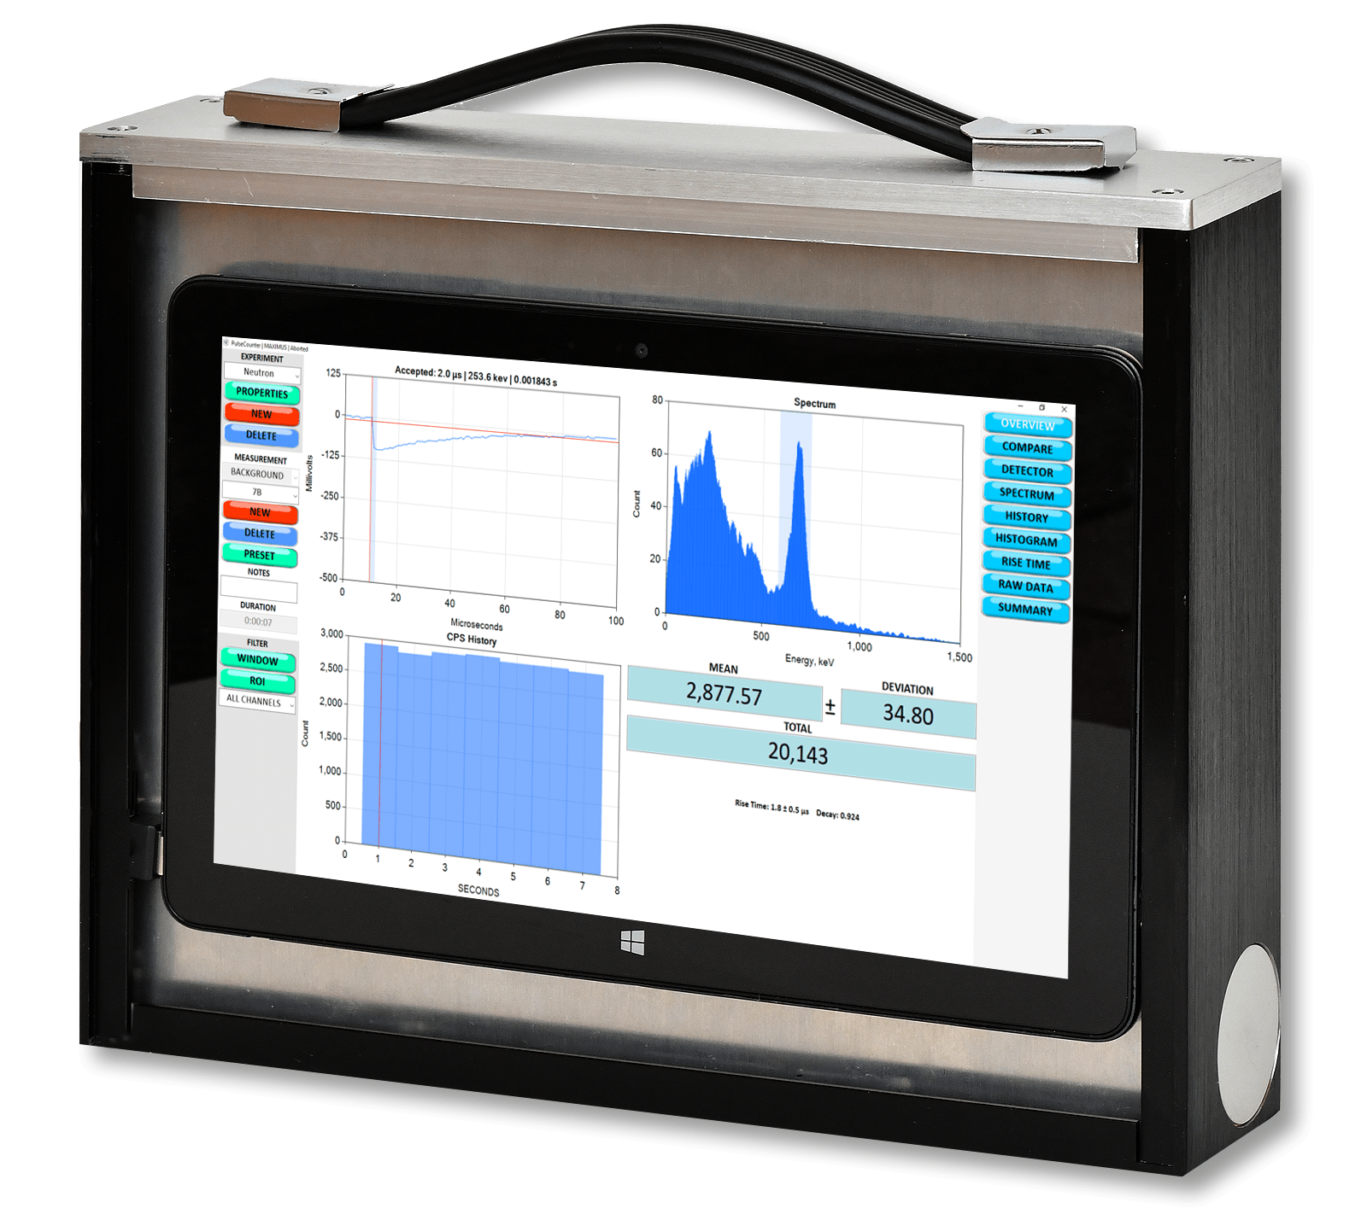
GAMMA-PRO NaI(Tl) Spectrometer
http://maximus.energy/index.php/product/gamma-pro/

Slide 9
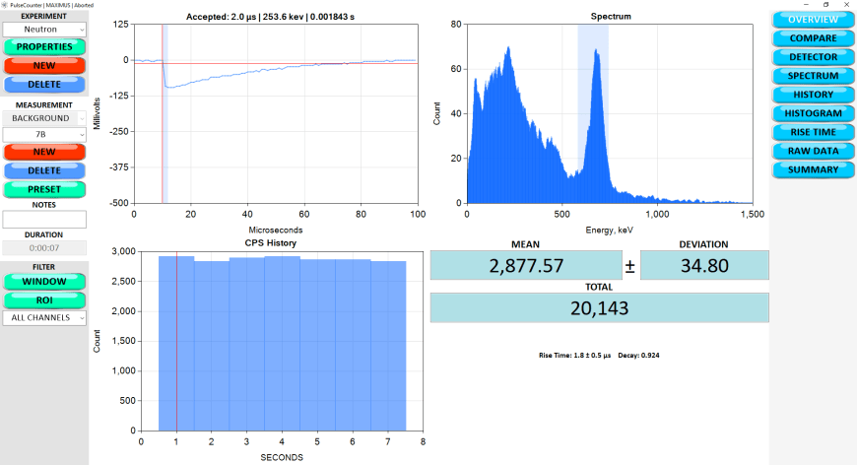
PulseCounter Software
http://maximus.energy/index.php/software/

Slide 10
NaI Detector Properties
Sensitivity: depends on size (width and thickness) of scintillator crystal;
Energy Range: from 10 keV to tens of MeV (depending on scintillator crystal thickness);
Resolution: energy-dependent; good crystals have ~30% @ 30 keV, ~7% @ 662 keV, 5% @ 1.3 MeV.
Central hole / well for compact sample measurement with 4π coverage.

Slide 11
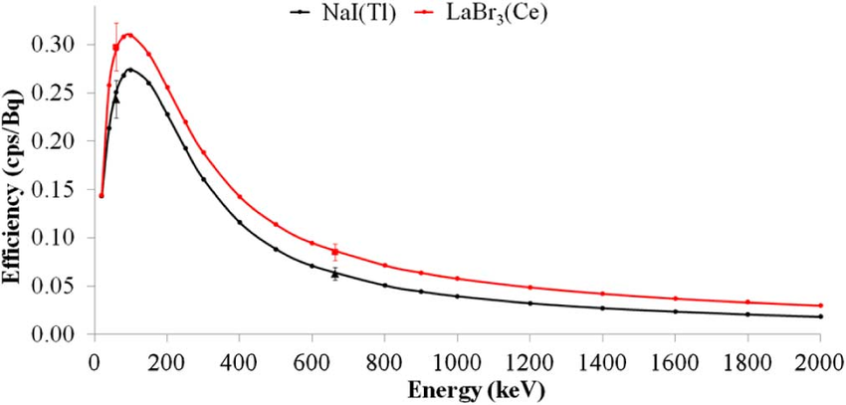
NaI Detector Efficiency
Exponentially decreases with gamma energy
Exponentially increases with scintillator crystal thickness
Has a maximum around ~100 keV
Absolute efficiency is 2-7% on average (depending on gamma spectrum)

Slide 12
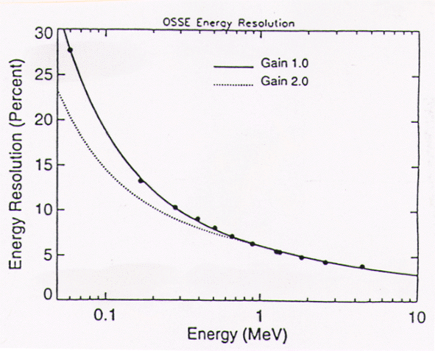
NaI Detector Resolution
Peak width decreases with the increase in gamma energy from ~30% @ 50 keV to ~5% @ > 1 MeV
NaI detectors are not very accurate for x-ray (<100 keV) spectroscopy due to poor resolution

Slide 13
Detectors: Area of Applicability
SDD – high resolution (~2% @ 6 keV), low sensitivity, max range from 0.2 to 100 keV; optimal range from 1 to 30 keV.
CdTe/CdTeZn/CZT – good resolution (~4% @ 662 кэВ), low sensitivity, max range from 1 keV to 1.5 MeV; optimal range from 1.5 to 100 keV.
NaI(Tl) – average resolution (~7-8% @ 662 keV), high sensitivity, max range from 10 keV 10 MeV; optimal range from 30 keV to 3 MeV.
HPGe – ultra-high resolution (0.2% @ 1.3 MeV), low sensitivity, useful range from 3 keV to 10 MeV (depending on type).

Slide 14
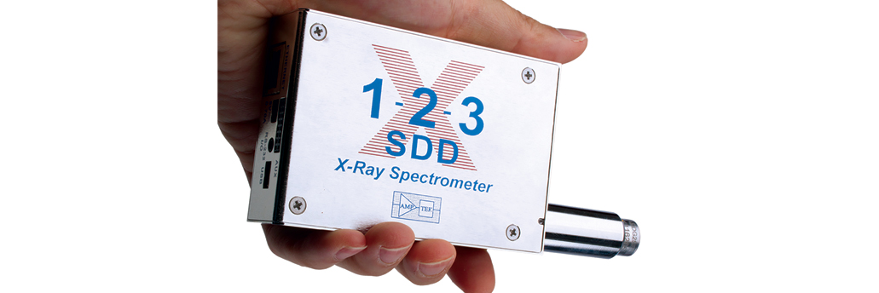
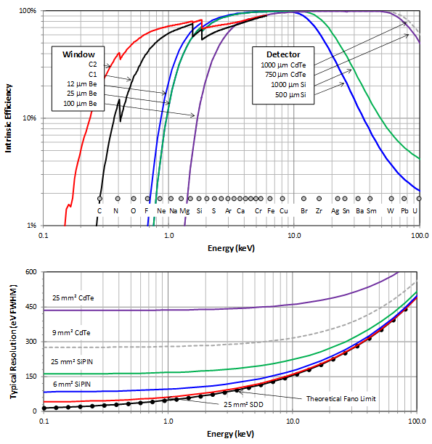
SDD
High Resolution: ~2% @ 6 keV
Low Sensitivity
Optimal Range: 1 – 30 keV
Maximum Range: 0.2 – 100 keV
Peak efficiency @ ~25 keV

Slide 15
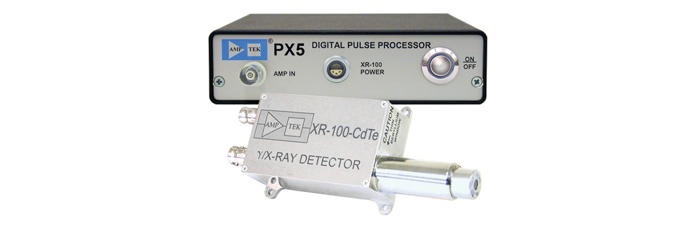
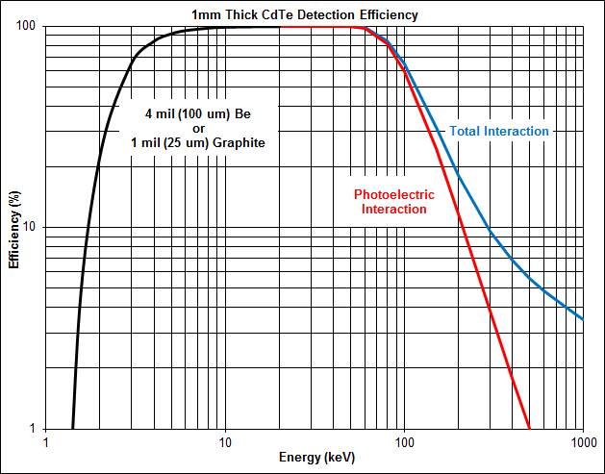
CdTe / CdZnTe / CZT
Good Resolution: ~4% @ 662 keV
Low Sensitivity
Optimal Range: 1.5 – 100 keV
Maximum Range: 1 keV – 1.5 MeV
Peak Efficiency @ ~10-60 keV

Slide 16
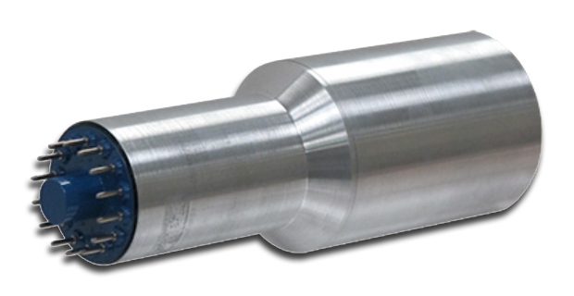
NaI, CsI
Average Resolution: ~7-8% @ 662 keV
High Sensitivity
Optimal Range: 30 keV – 3 MeV
Maximum Range: 10 keV – 10 MeV
Peak Efficiency @ ~100-200 keV

Slide 17
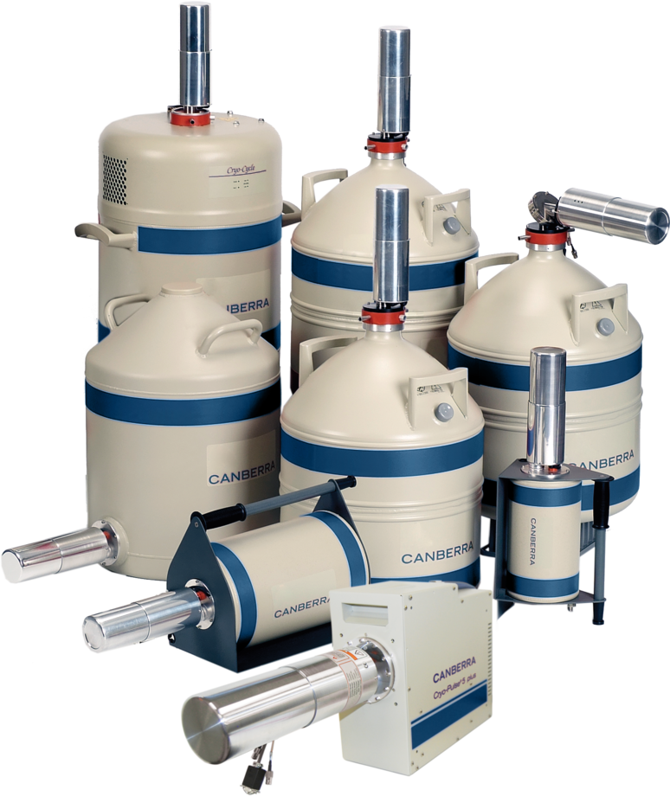
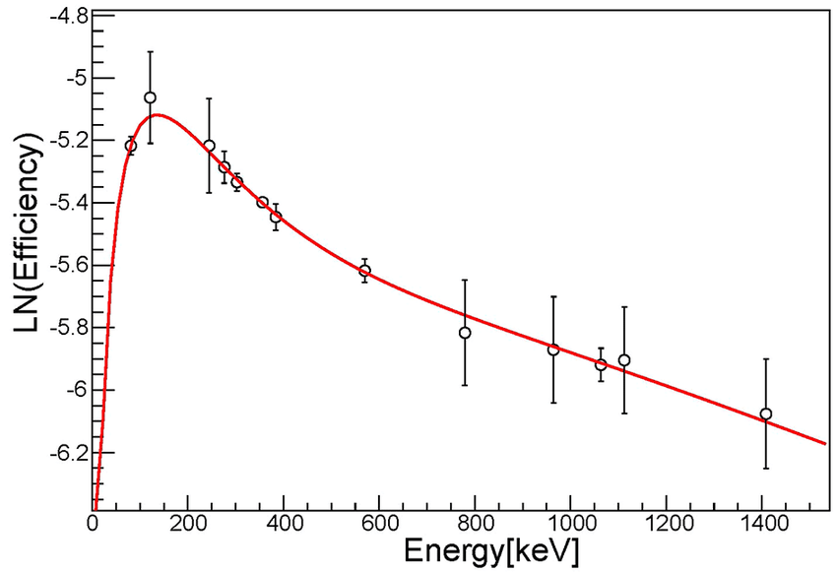
Germanium Detectors / HPGe
Ultra-High Resolution: ~0.2% @ 1.3 MeV
Low Sensitivity
Optimal Range Depends on Detector Type
Common Range: 3 keV – 3 MeV
Peak Efficiency @ ~200 keV

Slide 18
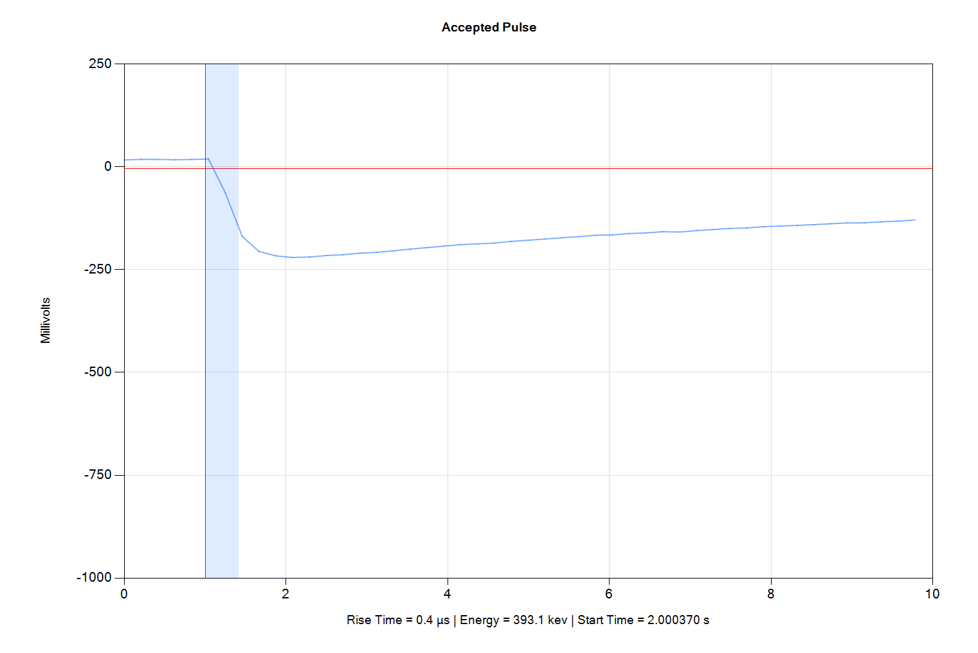
Typical NaI(Tl) Detector Signal

Slide 19
Typical NaI(Tl) Detector Signal
Base Level: 0V
Trigger Level (Discriminator): -10 mV
Pulse Amplitude: -200 mV
Pulse Width: ~20 μs
Rise Time : ~2 μs

Slide 20
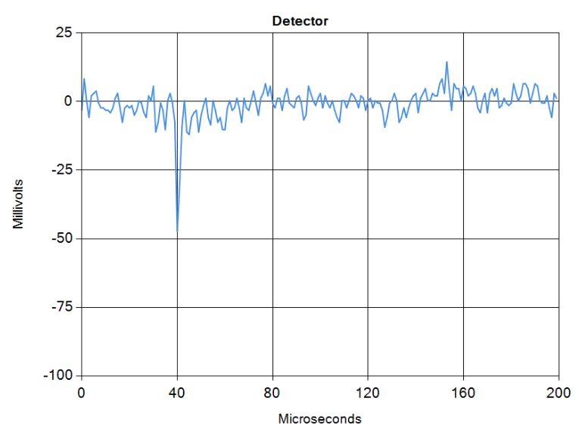
Exaggerated Signal
Noise
Trigger Level (Discriminator)
Useful Signal

Slide 21
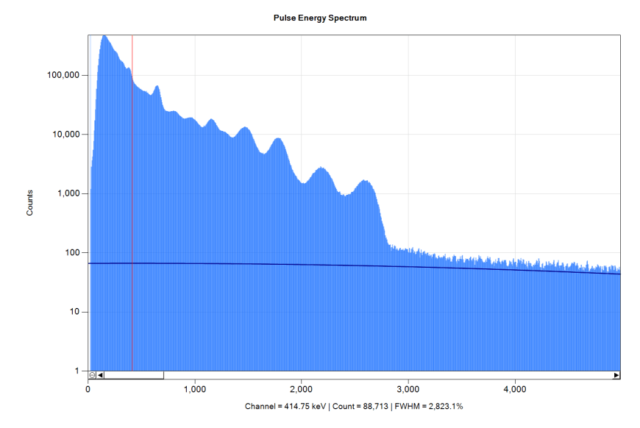
Natural NaI Gamma Background

Slide 22
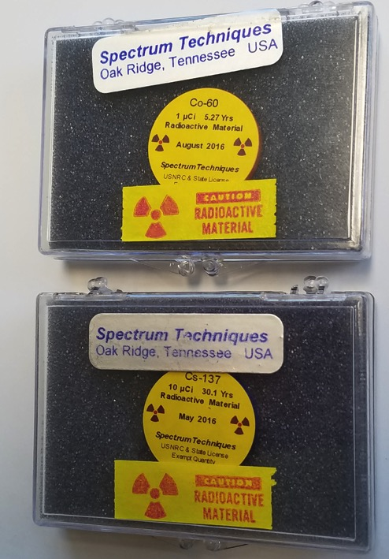
Calibration Sources
¹³⁷Cs, ⁶⁰Co and other calibration sources can be purchased at @ www.imagesco.com;
One has to have at least two calibration peaks in the energy range of interest;
One should check calibration before
every experiment
(no “stale” calibration).

Slide 23
Sources of Systematic Errors
Intrinsic noise produces false peaks in the low spectrum channels;
Periodic EM interference may produce false peaks across all spectrum channels, may shift/distort energies of spectral peaks;
Magnetic field interferes with PMT operation;
Concurrent gammas cannot be resolved and register as a single gamma of cumulative energy;
Temperature change results in shift of spectral peaks;
Unintended shielding with human body or equipment may drastically affect counts and spectral peaks;
Strong gamma sources produce x-ray fluorescence (XRF) peaks;
Calibration non-linearity limits accuracy of energy resolution;
Contamination (including with radon) may produce natural radioactivity peaks (e.g. ²¹⁴Pb);
Natural background may vary significantly, especially when only a few samples are taken.

Slide 24
Controlling Systematic Errors
Intrinsic noise is mitigated by increasing the trigger level, which results in loss of low-energy gammas;
Periodic EM interference is mitigated by shielding and ground loop elimination;
Magnetic field is mitigated by screening the PMT with mu-metal and situating detectors away from magnets and high current sources;
Concurrent gammas can be resolved by switching from slow NaI to fast EJ-232 scintillator;
Temperature change can be mitigated by thermostat or by frequent recalibration;
Shielding can be mitigated by fixing the detector position and preventing human or equipment movement during measurement;
Calibration non-linearity can be mitigated by employing multiple calibration sources;
Contamination with atmospheric radon can be mitigated by operating in a hermetically sealed environment;
Natural background should be checked periodically and sampled sufficiently (at least 20 samples).

Slide 25
Random Processes
We are dealing with random processes. That is why we cannot draw conclusions after making only 1-2 (or a handful) of measurements;
Too few measurements can yield odd patterns, including some pretty incredible ones;
“Non-repeatable” results are (most likely) just odd samples drawn from random distribution.

Slide 26
Statistical Analysis
Sample the background: ≥20 samples
Sample the experiment: ≥20 samples
Calculate P-value: if the value is less than 5% it is customary to consider the difference between the experiment and the background to be “statistically significant”.
If the P-value changes significantly with the addition or removal of samples – you do not have enough samples in your data set.

Slide 27
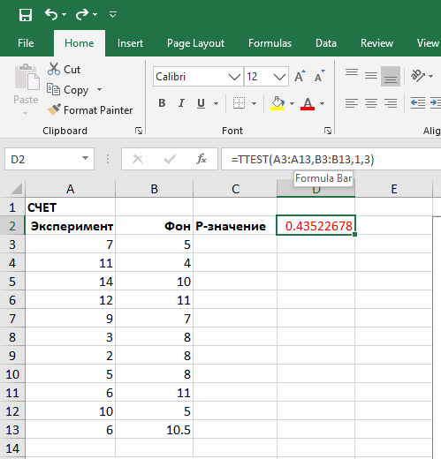
How to Calculate P-Value in Excel

Slide 28
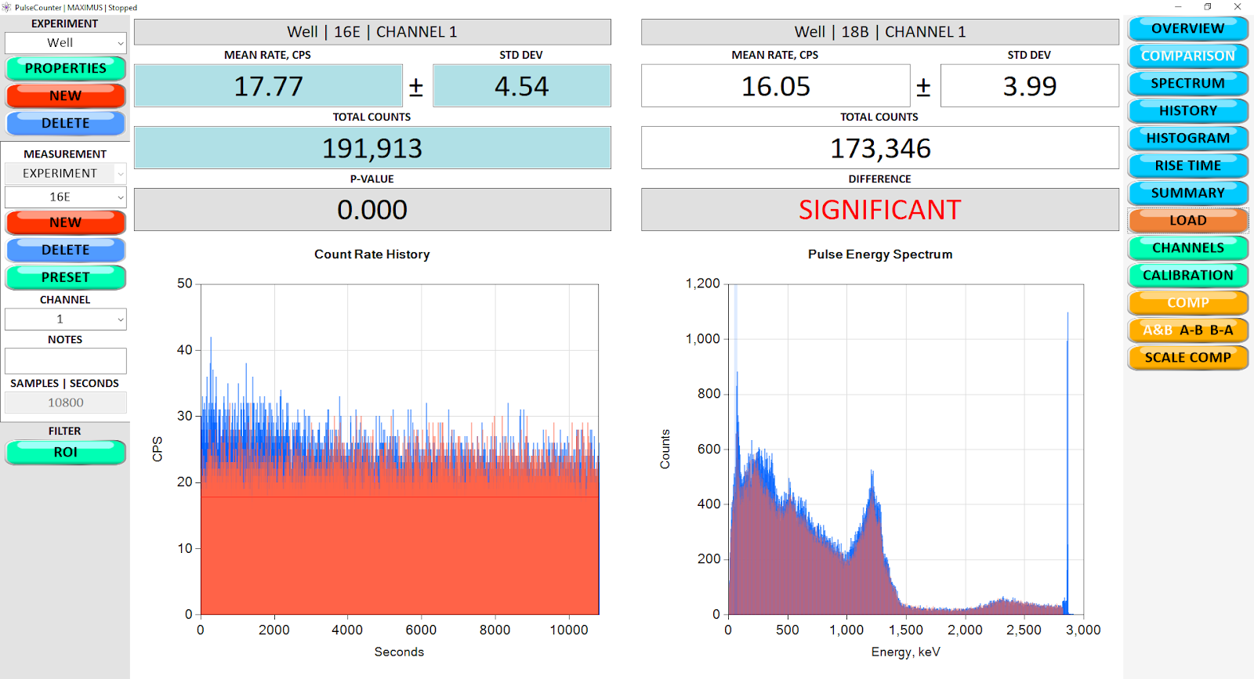
Statistical Analysis in PulseCounter
Линия свинца

Slide 29
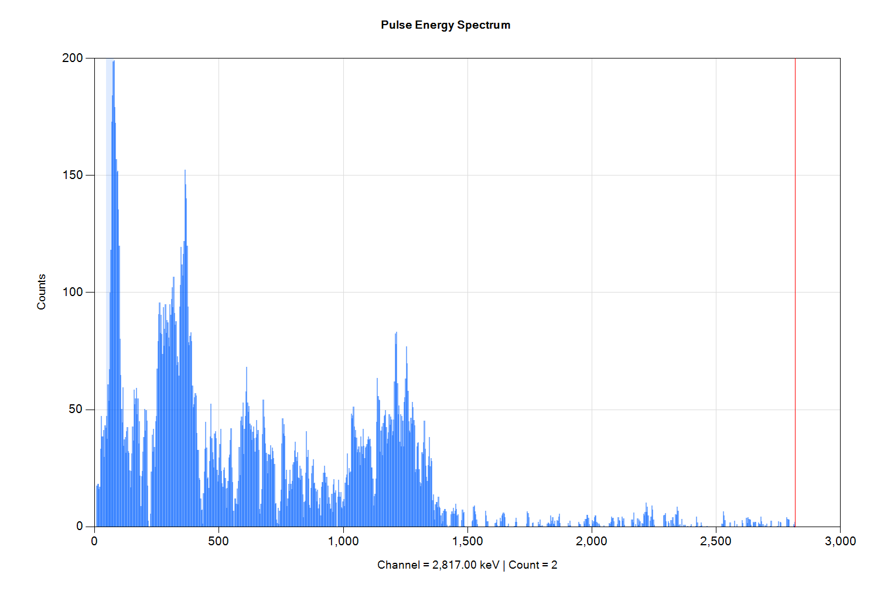
X-Ray Liminescence
Lead Peak

Slide 30
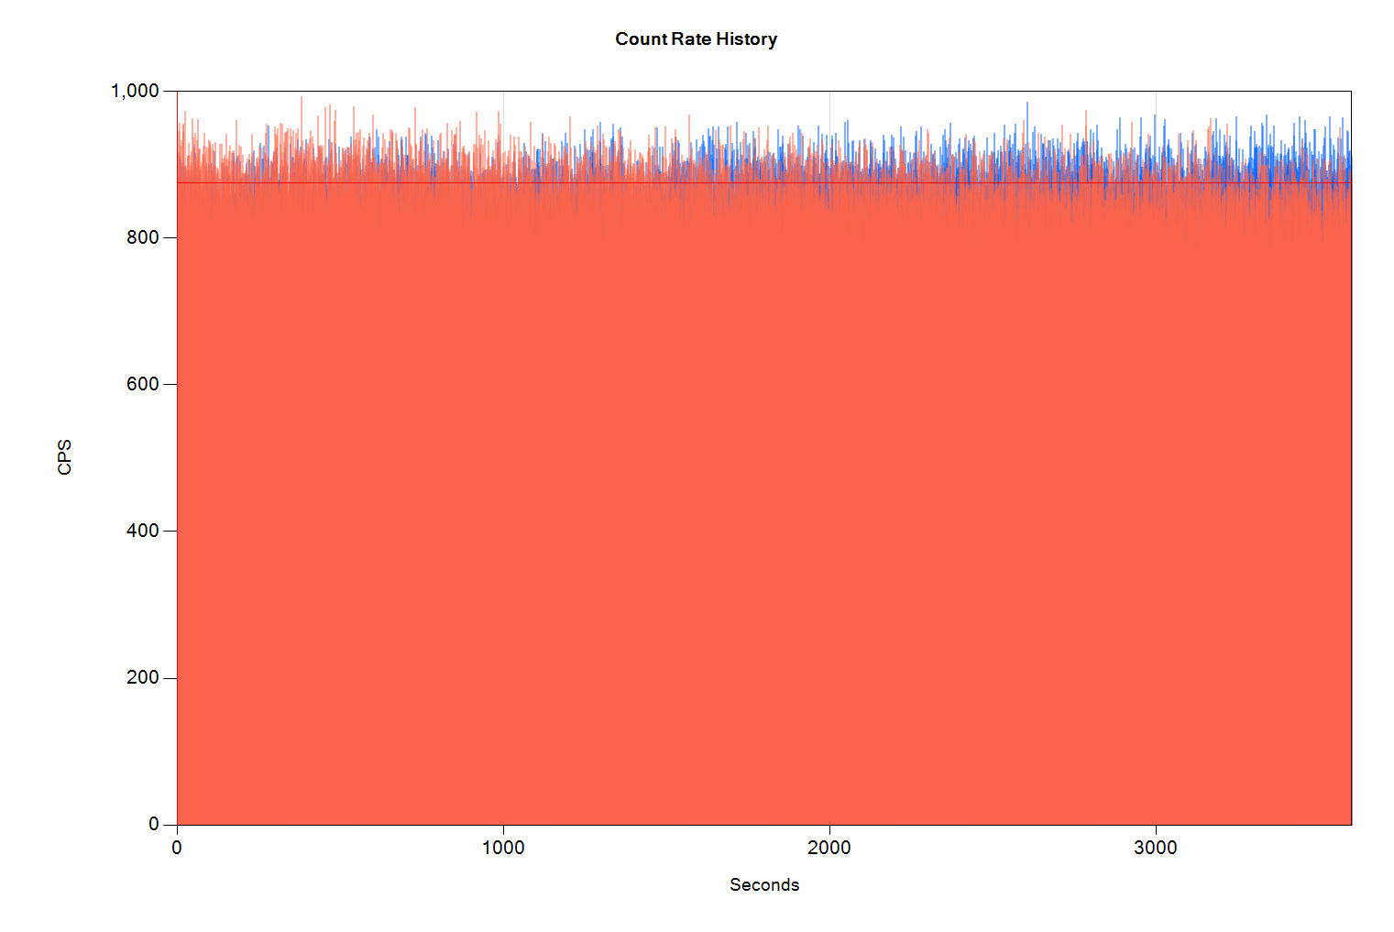
Shielding
I stood next to the detector and
screened some background

Slide 31
Amplification of the Effect
Increasing the number of measurements should result in P-value decrease (i.e. improved statistics);
Using more sensitive (in the energy range of interest) detector should result in the increased signal;
Using lead screen for background shielding should increase the signal;
Using metal filters to reduce or eliminate gamma rays of certain energies should affect the signal accordingly.

Slide 32
“Gold Standard” Publication Criterion
A publishable paper must have:
Detailed description of measurement equipment and measurement methodology;
Description of calibration process;
Multiple / periodic background measurements;
Repeatable results (somewhat repeatable is OK, 100% repeatability is not required);
Multiple measurements pertaining to the effect (must have significant sample);
Statistical analysis and P-value calculation when comparing measurements;
Analysis of systematic errors: show that you have gone at reasonable length to eliminate them;
‘Blank’ control experiment with null-result;
Control experiment that increases or decreases the effect;
Mandatory secondary confirmation e.g. using principally different measurement equipment and/or alternative measurement methodology;
Peer review, especially from experts in measurement techniques and data interpretation.

Slide 33
Useful Resources
http://maximus.energy/index.php/product-category/gamma/
http://maximus.energy/index.php/2020/05/09/search-for-alpha-decay-acceleration/
https://www.picotech.com/products/oscilloscope
https://www.amptek.com/products/sdd-x-ray-detectors-for-xrf-eds/xr-100sdd-silicon-drift-detector

